Slide 1

“Website using
React.js"
Task - 3

Slide 2

Website using react.js
React is a popular JavaScript library used for building user
interfaces (Uls) in web applications.
React is widely used in web development due to its fast rendering capabilities and ability to handle complex UI components.
LMS Username | Name | Batch
2115a920 | GOKULA KRISHNAN A | A9
2115a921 | GOKULNATH K | A9
2115a941 | RAMVILAS H | A9
2115a930 | KARTHIKEYAN B | A9

Slide 4
INTRODUCTION
REACT.js

Slide 5
It can be used to develop small applications
as well as big, complex applications.
The main objective of ReactJS is to develop User Interfaces (UI) that improves the speed of the apps. It uses virtual DOM (JavaScript object), which improves the performance of the app. The JavaScript virtual DOM is faster than the regular DOM.
In React, you develop your applications by creating reusable components that you can think of as independent Lego blocks. These components are individual pieces of a final interface, which, when assembled, form the application's entire user interface.

Slide 6
SOURCED CODE:
<!DOCTYPE html>
<html>
<head>
<title>Codetown</title>
<style>
body {
font-family: Arial, sans-serif;
font-size: 16px;
}
header {
background-color: red;
padding: 20px;
text-decoration:overlin

Slide 7
nav a {
color:yellow;
text-decoration:bold;
}
main {
padding: 20px;
display: flex;
flex-wrap: wrap;
}
section {
background-color:pink;
flex-basis: 33%;
padding: 10px;
}

Slide 8
nav {
background-color:#333;
color:#fff;
padding: 10px;
}
nav ul {
margin: 4;
padding: 0;
list-style:disc;
display: flex;
}
nav li {
margin: 0 10px;
}

Slide 9
h2 {
margin-top: 0;
}
h3{
background-color:black;
color:gold;
padding:60px;
font-size:60px;
font-weights:bold;
}
ul {
list-style: square;
padding: 0;
margin: 0;
}

Slide 10
form {
display: flex;
flex-direction: column;
max-width: 400px;
}
label {
margin-bottom: 10px;
}
input[type="text"],
input[type="email"],
textarea {
padding: 10px;
margin-bottom: 10px;
border: 1px solid #ccc;
border-radius: 4px;
}
input[type="submit"] {
background-color: "pink";
color:"blue";
padding: 10px 20px;
border:solid;
border-radius: 4px;
cursor: pointer;
}
input[type="submit"]:hover {
background-color: "purple";
}
</style>
</head>

Slide 11
<body> background="C:\Users\Windows\Downloads\lo.jpg">
<img src="C:\Users\Windows\Downloads\ct.jpg">
<header>
<h1>#CODETOWN</h1>
</header>
<h3>Welcome to #Codetown</h3>
<nav>
<ul>
<li><a href="intro.txt">Home</a></li>
<li><a href="about.txt">About</a></li>
<li><a href="cont.txt">Contact</a></li>
</ul>
</nav>
<main>
<section>
<h2>About Us</h2>
<p>At codetown Web Development, we're passionate about building beautiful, functional websites that help businesses succeed online.</p>
<a href="lm.txt">Learn More</a>
</section>
<section>
<h2>Our Services</h2>
<ul>
<li>Web Design</li>
<li>Web Development</li>
<li>SEO</li>
</ul>
</section>

Slide 12
<section>
<h2>Contact Us</h2>
<form>
<label for="name">Name:</label>
<input type="text" id="name" name="name"><br><br>
<label for="email">Email:</label>
<input type="email" id="email" name="email"><br><br>
<label for="message">Message:</label>
<textarea id="message" name="message"></textarea><br><br>
<input type="submit" value="Submit">
</form>
</section>
</main>
<footer>
<p>Copyright &copy; 2023-#codetown.All Rights Reserved.<br></br>
Designed & Developed by #codetown.</p>
</footer>
</body>
</html>
import React from 'react';
import { Link } from 'react-router-dom';
const Navbar = () => {
return (
<nav>
<ul>
<li><Link to="/">Home</Link></li>
<li><Link to="/login">Login</Link></li>
<li><Link to="/register">Register</Link></li>
<li><Link to="/transfer">Transfer</Link></li>
<li><Link to="/history">Transaction History</Link></li>
</ul>
</nav>
);
};
export default Navbar;

Slide 13
import React, { useState } from 'react';
import { Link } from 'react-router-dom';
import axios from 'axios';
const Login = () => {
const [email, setEmail] = useState('');
const [password, setPassword] = useState('');
const handleSubmit = async (e) => {
e.preventDefault();
try {
const response = await axios.post('/api/login', { email, password });
console.log(response.data);
} catch (error) {
console.log(error);
}
};

Slide 14
return (
<form onSubmit={handleSubmit}>
<label>
Email
<input type="email" value={email} onChange={(e) => setEmail(e.target.value)} />
</label>
<label>
Password
<input type="password" value={password} onChange={(e) => setPassword(e.target.value)} />
</label>
<button type="submit">Login</button>
<p>Don't have an account? <Link to="/register">Register here.</Link></p>
</form>
);
};
export default Login;
import React, { useState } from 'react';
import axios from 'axios';
const Transfer = () => {
const [recipient, setRecipient] = useState('');
const [amount, setAmount] = useState(0);
const handleSubmit = async (e) => {
e.preventDefault();
try {
const response = await axios.post('/api/transfer', { recipient, amount });
console.log(response.data);
} catch (error) {
console.log(error);
}
};

Slide 15
return (
<form onSubmit={handleSubmit}>
<label>
Recipient
<input type="text" value={recipient} onChange={(e) => setRecipient(e.target.value)} />
</label>
<label>
Amount
<input type="number" value={amount} onChange={(e) => setAmount(e.target.value)} />
</label>
<button type="submit">Transfer</button>
</form>
);
};
export default Transfer;
import React, { useEffect, useState } from 'react';
import axios from 'axios';
const TransactionHistory = () => {
const [transactions, setTransactions] = useState([]);
useEffect(() => {
const fetchTransactions = async () => {
try {
const response = await axios.get('/api/transactions');
setTransactions(response.data);
} catch (error) {
console.log(error);
}
};
fetchTransactions();
}, []);
return

Slide 16
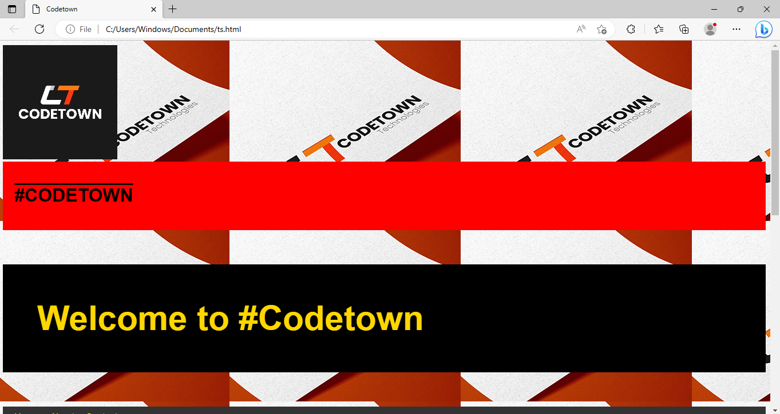

Slide 17
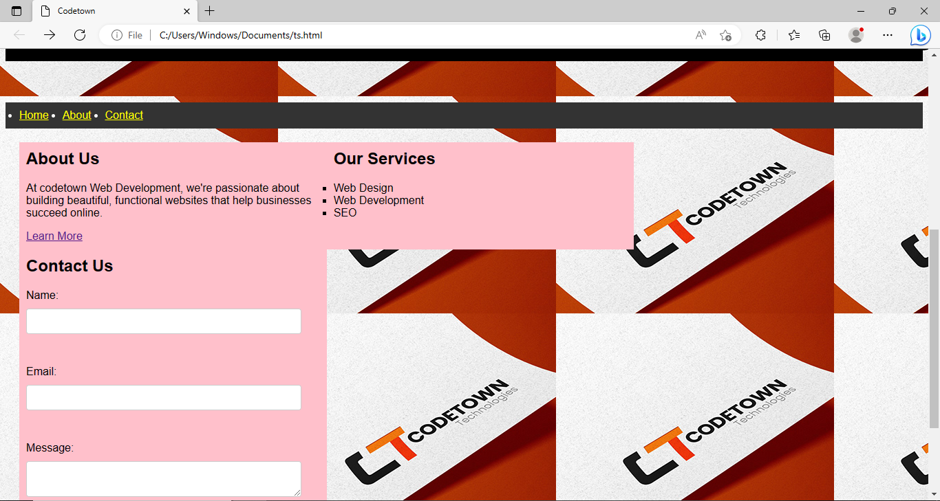

Slide 18
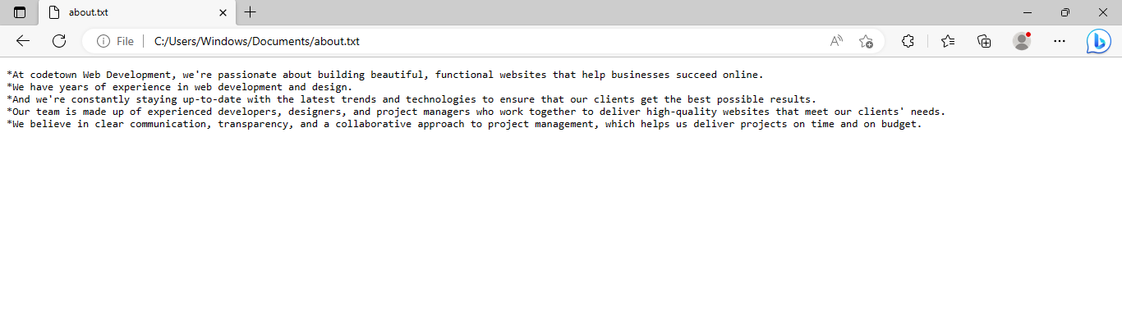

Slide 19
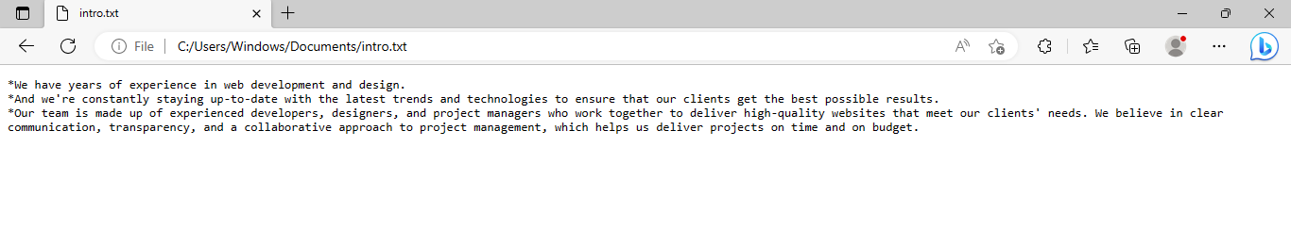
HOME-

Slide 20
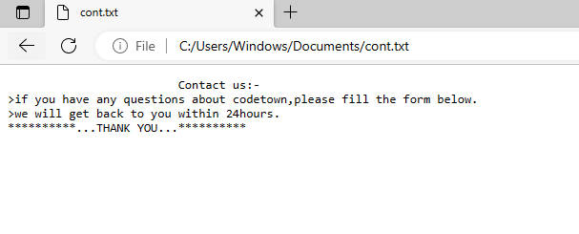

Slide 21
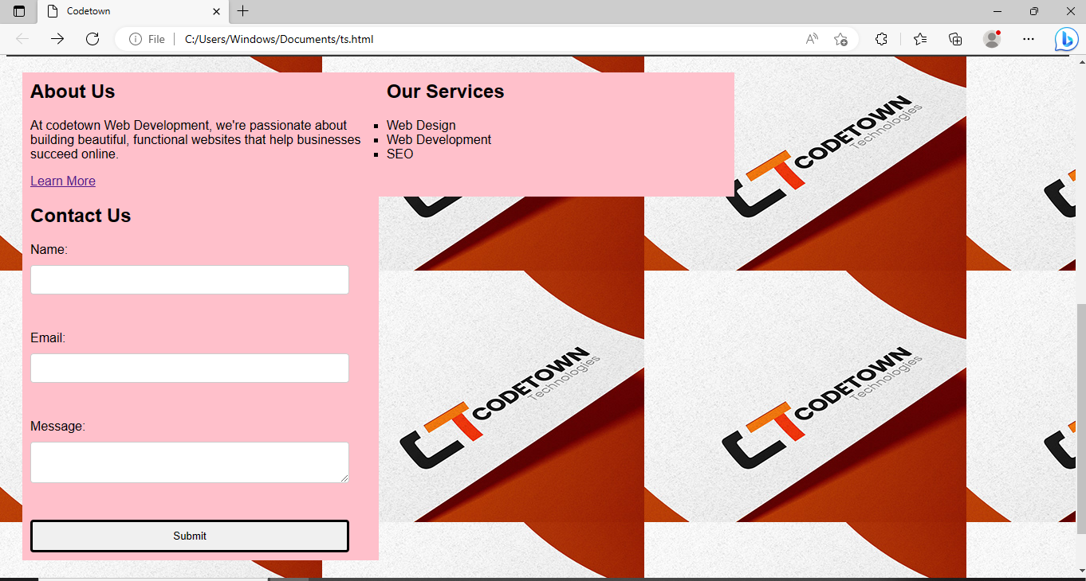

Slide 22
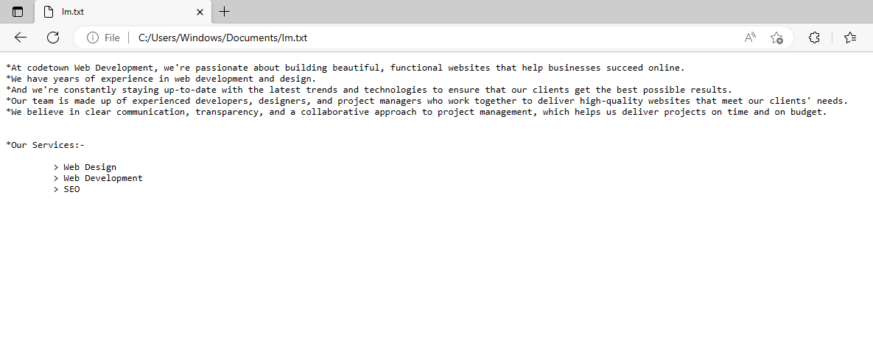

Slide 23
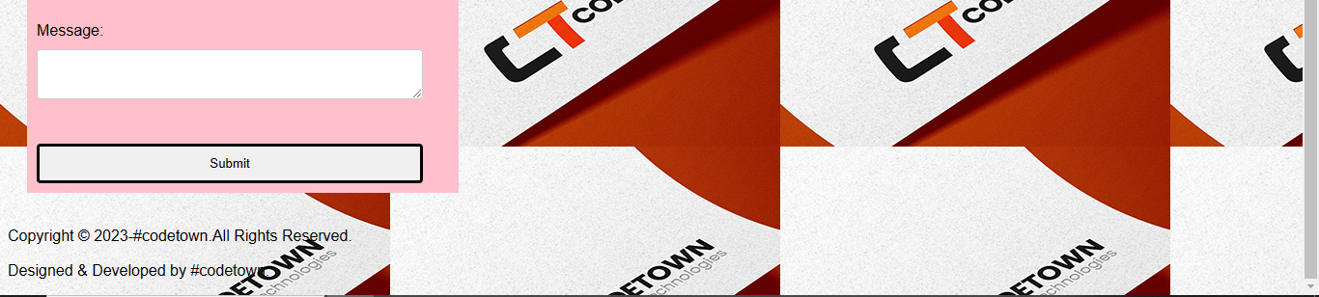

Slide 24
CONCLUSION
In summary, UI for React refers to the visual interface of a web application built using the React library.
React provides developers with a flexible and scalable way of building UI components that can be easily integrated into different parts of the application.
The declarative nature of React makes it easier to manage and maintain the application's Ul over time.

Slide 25
Submission Github
https://github.com/karthick5000/karthick5000.git

Slide 26


